Slide 1
GROUP-
NAME ID
1.TASNIMUL KHALID KHAN 1611722630
2.AHMAD YEASEEN 1631454630
3.SURAIYA NUSRAT 1620980020
4.UMME MARZINA 1711538630
5.S M ZIHADUL HAQUE 1611182615
6.JAHURA HOSSAIN 1520529631

Slide 2
Tuberculosis
A DEADLY YET CURABLE DISEASE

Slide 3
Tuberculosis is an infectious bacterial disease characterized by the growth of nodules (tubercles) in the tissues, especially the lungs.
Compared with other diseases caused by a single infectious agent, tuberculosis is the second biggest killer, globally.(MEDICAL NEWS TODAY)
In 2015, 1.8 million people died from the disease, with 10.4 million falling ill.

Slide 4
The cause of TB is the Mycobacterium tuberculosis bacteria . It is spread through the air through the saliva(sneezing, coughing) of an active TB infected person.
LATENT TB: They are infected with M. tuberculosis, but do not have TB disease. The bacteria is inactive and not contagious. It can only be detected through tuberculin skin test or TB blood test.
ACTIVE TB: In some people, TB bacteria destroys the immune system’s defenses and begin to multiply, resulting in the progression from latent TB infection to TB disease.

Slide 5
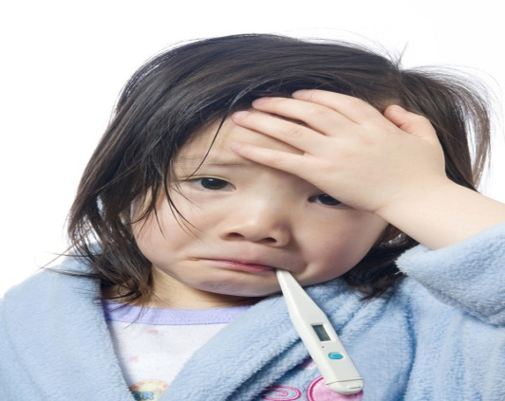

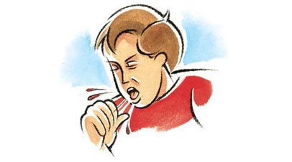
SYMPTOMS
Coughing, sometimes with mucus or blood
Chills
Fatigue

Slide 6

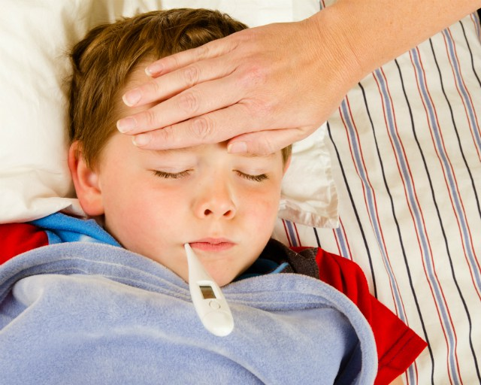
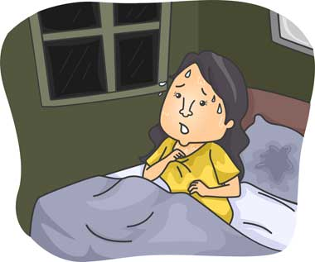

Fever
Loss of weight
Loss of appetite
Night sweats

Slide 7
TREATMENT:
Multi-drug treatment is employed to treat active TB disease. Depending on state or local public health regulations, you may be asked to take your antibiotics under the supervision of your physician or other healthcare professional. This program is called "Directly Observed Therapy“.
designed to prevent abandonment or erratic treatment, which may result in "failure" with continued risk of transmission or acquired resistance of the bacteria to the medications, including the infamous multi-drug resistant TB (MDR-TB).

Slide 8

Case briefing:
HELLO !! I AM A PUBLIC HEALTH OFFICER
vaccination
HIV prevention
Breastfeeding tips
TB treatment and follow up

Slide 10
IDENTIFIED PROBLEMS
conservative society
Male dominating society
No social Awareness on TB
No education
Stigma in the community

Slide 11
PROPOSED SOLUTIONS:
Reducing male dominance
Increasing literacy rate
Social awareness
solution

Slide 12
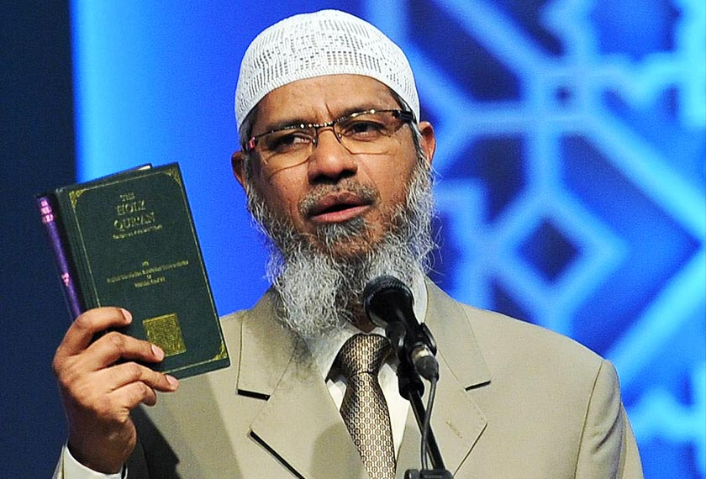
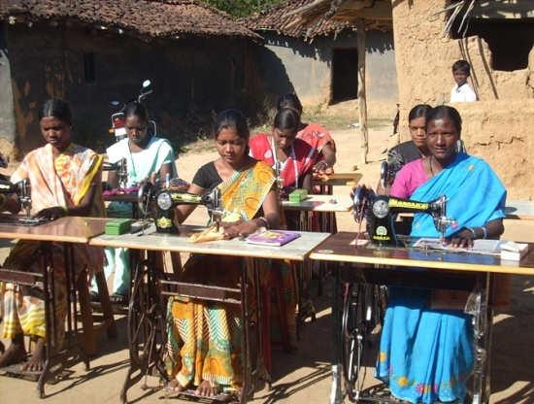


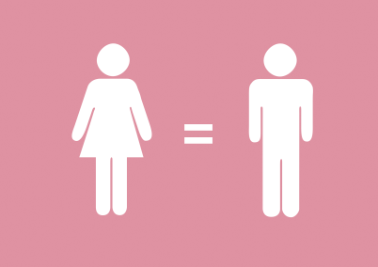
Male dominance
A male-dominated society is one that benefits men in laws, education, academia and day-to-day life.
Reduction of Male dominance
clearing Misconception on religion
Participation of women in earnings
Changing women’s mentality
Improving men’s mentality
Move towards openmindedness

Slide 13
Social Awareness
Promoting on different media
Arranging seminar
Plays with morals

Slide 14
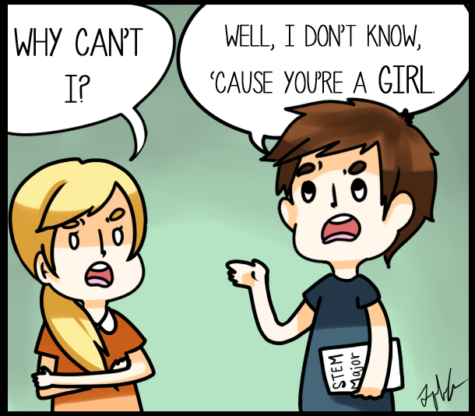
STIGMA: (DUE TO LACK OF SOCIAL AWARENESS)
REMOVING SUPERSTITION
REDUCING DISCRIMINATION

Slide 15

IMPROVING LITERACY RATE
ENCOURAGE SCHOOL-GOING
HOLD SEMINARS ON IMPORTANCE OF EDUCATION
DEPENDENCE OF HEALTH ON EDUCATION

Slide 16
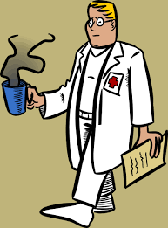
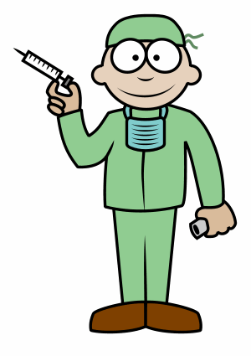


ENCOURAGEMENT(to go to clinic)
CONSULTING WITH EXPERT DOCTORS
BRINGING CLINIC TO COMMUNITY(2 points)
MALE SHOULD ENCOURAGE FEMALE TO GO TO CLINIC
PRIORITY TREATMENT ON OTHER DISEASES

Slide 17
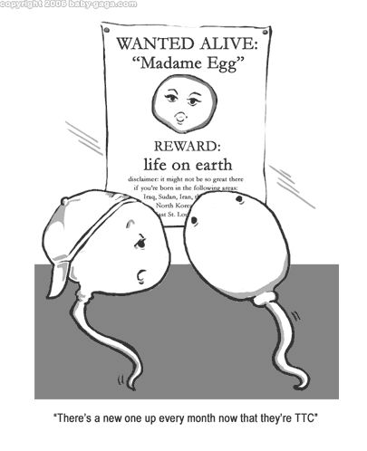
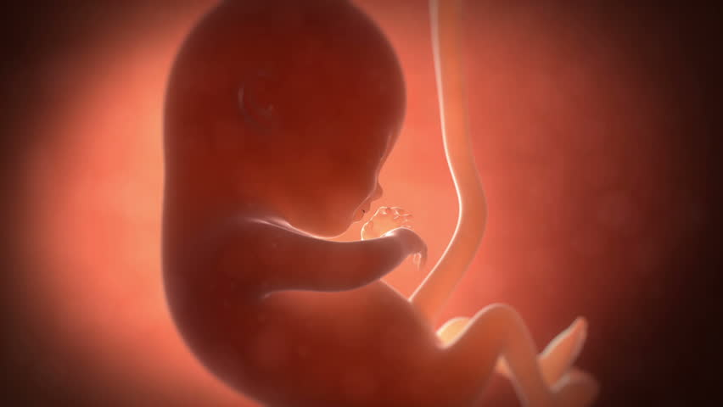
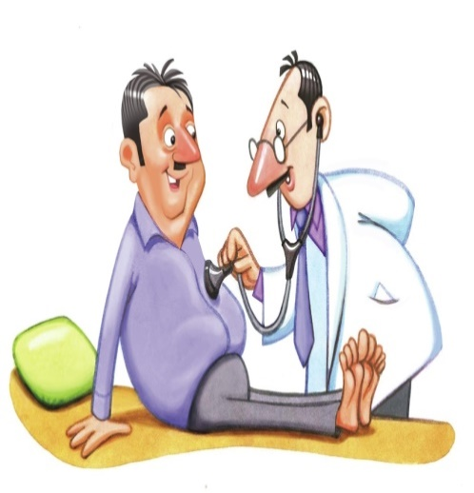
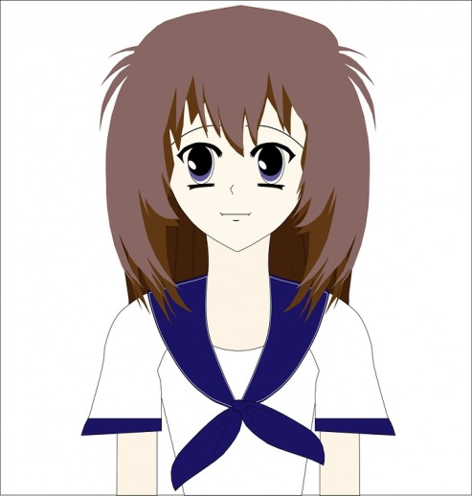
MOTIVATION(to go to clinic)
Infertility
ATT harms fetus
TB checkup before conceiving
Adolescent girls are more vulnerable

Slide 18

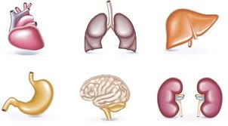
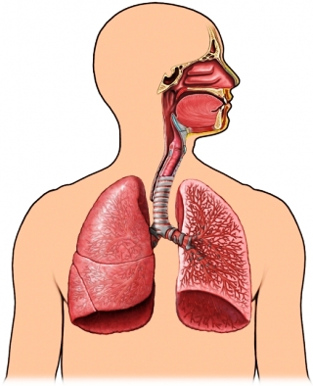
TB Is fatal, affects important organs
Severe lung damage if not treated
Family breakup

Slide 19
To conclude:
Tuberculosis is simply a disease and should not be feared or stigmatized . REMEMBER THE MAGIC LINES:
“cure TB,
live happy and
make plenty of babies.”

